Slide 1
CS-2001 Data Structures
Advanced Sorting Algorithms
Week 7 | Lecture 19-21

Slide 2
Topics
Selection Sort
Shell Sort
Comb Sort
Merge Sort
Quick Sort
Radix Sort
Linear Search
Binary Search
Interpolation Search

Slide 3
Selection Sort
Selection sort is a sorting algorithm, specifically an in-place comparison sort.
It has O(n²) time complexity, making it inefficient on large lists.
Initially, the sorted array is empty and the unsorted array is the entire input list. The algorithm proceeds by finding the smallest (or largest, depending on sorting order) element in the unsorted array, exchanging (swapping) it with the leftmost unsorted element (putting it in sorted order), and moving the array boundaries one element to the right.

Slide 4
Selection Sort Algorithm
for i=0 to n-1 // outer for loop
min = i // set min value to i
for j=i+1 to n // inner loop
if arr[j] less than arr[min] then // check which element is smaller
min=j // store index of smallest element to min
end for // inner loop
if min not equal to i then // swap if min does not match to i
swap arr[min] with arr[i] // swapping
end for // outer for loop

Slide 5
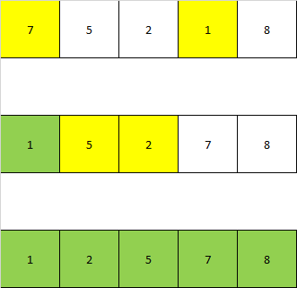
Selection Sort

Slide 6
Selection Sort Advantages and Disadvantages
Advantages
The main advantage of the selection sort is that it performs well on a small list.
Because it is an in-place sorting algorithm, no additional temporary storage is required beyond what is needed to hold the original list.
Its performance is easily influenced by the initial ordering of the items before the sorting process.
Disadvantages
The primary disadvantage of the selection sort is its poor efficiency when dealing with a huge list of items.
The selection sort requires n-squared number of steps for sorting n elements.

Slide 7
Shell Sort
Shell Sort is an in-place comparison sort. It is mainly a variation of sorting by exchange (bubble sort) or sorting by insertion (insertion sort). This algorithm avoids large shifts as in case of insertion sort, if the smaller value is to the far right and has to be moved to the far left. The idea of shell sort is to allow exchange of far items. This spacing is termed as interval or gap.

Slide 8
Shell Sort Working
Step 1 − Initialize the value of gap/interval (n/2 iteratively)
Step 2 − Compare 2 elements at the distance of gap at every iteration
Step 3 − if element at the left is smaller than element at the right, perform swap or shift.
Step 4 − Repeat step 3 until complete array is sorted.

Slide 9
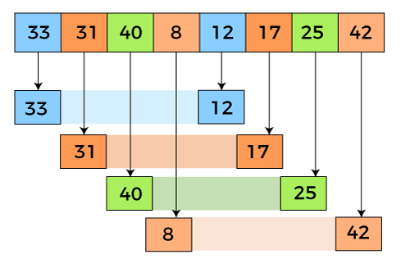

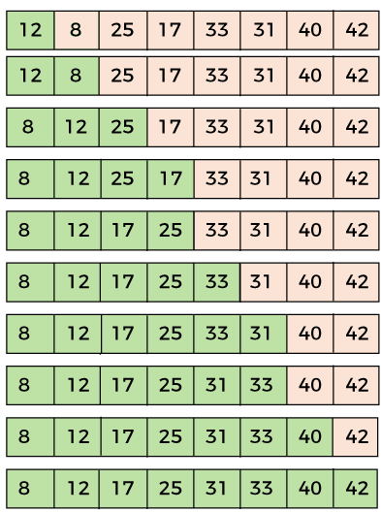

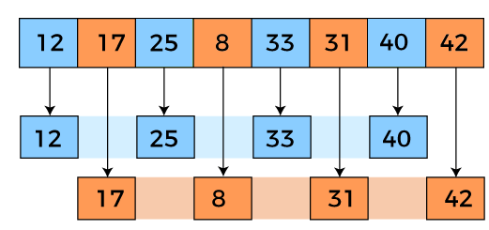
Shell Sort

Slide 10
Shell Sort Advantages and Disadvantages
Advantages:
With improved Average time complexity, it is a very efficient algorithm for medium size arrays.
It is better than Insertion sort and 5 times faster than Bubble sort.
Disadvantages:
It is a complex algorithm.
Not as efficient as merge sort and quicksort.
Limited to use for small size arrays as the performance decreases with an increase in array size.

Slide 11
Comb Sort
Comb sort is a comparison based sorting algorithm which improves on bubble sort. Comb sort uses a larger gap and works on bubble sort strategy. We define a variable gap and the elements separated by the gap are compared and swapped to get sorted order of elements.
The gap is initialized as size of the array and after every iteration the gap is reduced by a shrink factor as described in the below algorithm steps.
The iteration continues till the gap becomes 1. So the last iteration of this algorithm is same as a bubble sort iteration.
The best shrink factor has been found to be 1.3.

Slide 12
Comb Sort Algorithm
1.Create variables gap and swapped and constant SHRINK_FACTOR and initialize as below: i. gap = size of the array ii. swapped = false iii. SHRINK_FACTOR = 1.3 'swapped' is used to check whether any 2 elements have been swapped at the end of an iteration, like it is used in Bubble Sort algorithm for optimization. 2. Set swapped = false 3. Set gap = (int) (gap/SHRINK_FACTOR). 4. Iterate over the array from i = 0 to i < n - gap: a. If array[i] > array[i + gap] i. swap the elements array[i] and array[i + gap], to arrange in sorted order ii. set swapped = true 5. Repeat steps 2-4 while gap != 1 and swapped = true

Slide 13


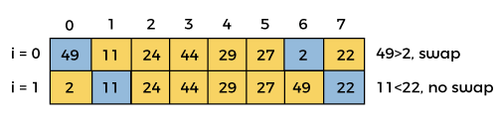
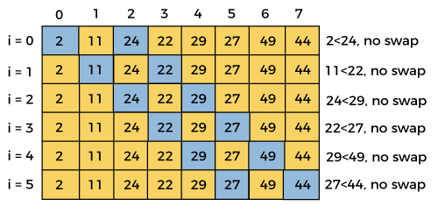

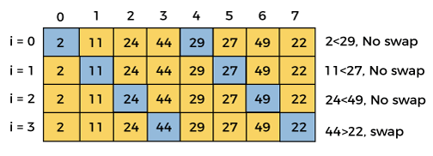

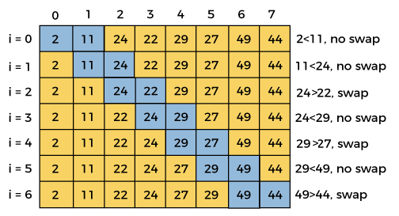

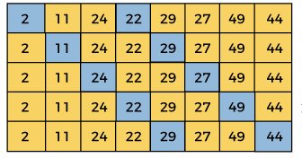

Comb Sort

Slide 14
Comb Sort Advantages and Disadvantages
ADVANTAGES:
It does not require extra spaces to sort the elements.
It works better than bubble sort though both are similar.
The logic is simple and it is reliable.
DISADVANTAGES:
Worst-case complexity is the same as the complexity of bubble sort.
Does not work well for a large number of data.
It is not a stable sort.

Slide 15
Merge Sort
Merge Sort Algorithm is a Divide & Conquer algorithm. It divides input array in two halves, calls itself for the two halves(recursively) and then merges the two sorted halves. A separate merge() function is used for merging two halves.
Time Complexity: O(n*log(n))
Space Complexity: n

Slide 16
Merge Sort - Continue
There are 3 Phases in the Merge Sort Algorithm
Division Phase : Divide the array into 2 halves by finding the mid of the array.
Mid (m) = (left + right)/ 2
left is the starting index & right is the last index of the array
Recursion Phase
Call Merge Sort on the left sub-array
Call Merge Sort on the right sub-array
Merge Phase
Call merge function to merge the divided sub-arrays back to the original array.
Perform sorting of these smaller sub arrays before merging them back.

Slide 17
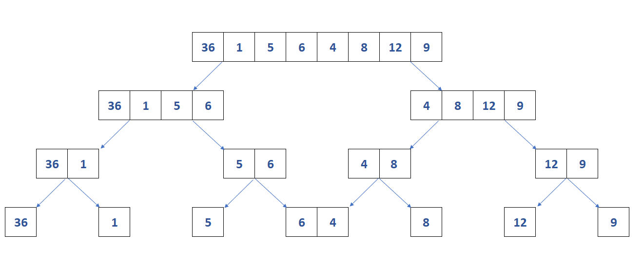
Merge Sort- Division

Slide 18
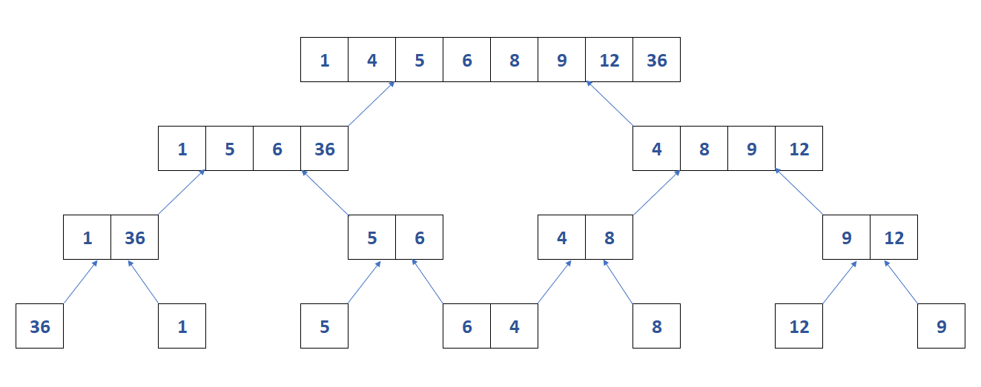
Merge Sort- Merging

Slide 19
Merge Sort - Algorithm
mergeSort(arr[],l,r)
{
if(l<r)
{
midpoint = (l+r)/2
mergeSort(arr,l,m)
mergeSort(arr,m+1,r)
merge(arr,l,m,r)
}
}

Slide 20
Merge Sort
Advantages
It is quicker for larger lists because unlike insertion and bubble sort it doesnt go through the whole list seveal times.
It has a consistent running time, carries out different bits with similar times in a stage.
Disadvantages
Slower comparative to the other sort algorithms for smaller tasks.
uses more memory space to store the sub elements of the initial split list.

Slide 21
Quick Sort
Quick Sort Algorithm is a Divide & Conquer algorithm. It divides input array in two partitions, calls itself for the two partitions(recursively) and performs in-place sorting while doing so. A separate partition() function is used for performing this in-place sorting at every iteration.
Time Complexity: θ(nlog(n))
Space Complexity: O(log(n))

Slide 22
Quick Sort - Continue
There are 2 Phases in the Quick Sort Algorithm.
Division Phase – Divide the array into 2 halves by finding the pivot point to perform the partition of the array.
The in-place sorting happens in this partition process itself.
Recursion Phase –
Call Quick Sort on the left partition
Call Quick Sort on the right partition.

Slide 23
Quick Sort - Algorithm
Quick Sort Algorithm
Quick Sort Partition Function
QuickSort(arr[], s, e)
{
if(s<e)
{
p = Partition(arr[],s,e)
QuickSort(arr[], s, (p-1))
QuickSort(arr[], (p+1), e)
}
}
Partition(arr[], s, e)
{
pivot = arr[e]
plndex=s
for (i=s to e-1)
{
if(arr[i]<=pivot)
{
swap(arr[i], arr[pIndex])
plndex++
}
}
swap(arr[e], arr[plndex])
return pIndex
}

Slide 24
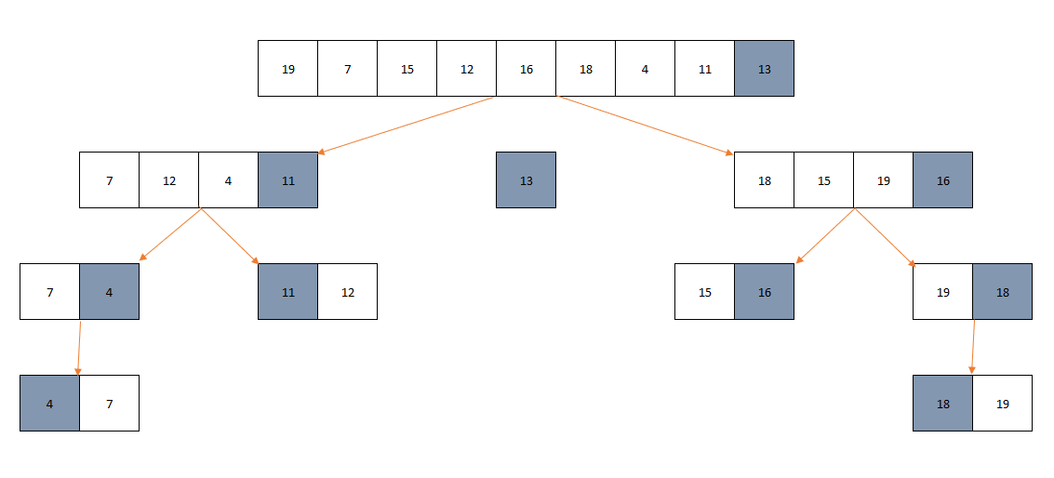
Quick Sort - Working

Slide 25
Quick Sort
Advantages
It is in-place since it uses only a small auxiliary stack.
It requires only n (log n) time to sort n items.
It has an extremely short inner loop.
Disadvantages
It is recursive. Especially, if recursion is not available, the implementation is extremely complicated.
It requires quadratic (n²) time in the worst-case.

Slide 26
Radix Sort
Radix sort is a non-comparative sorting algorithm. It avoids comparison by creating and distributing elements into buckets according to their radix. For elements with more than one significant digit, this bucketing process is repeated for each digit, while preserving the ordering of the prior step, until all digits have been considered. For this reason, radix sort has also been called bucket sort and digital sort.

Slide 27
Radix Sort Continue
Time complexity: O(d(n+k))
Space complexity: O(n+k)
Where d is the no of max digits of the largest no in the digit, n is the no of elements in the list and k is the range of unique elements. Note – This time & space complexity is applicable for those Radix sort algorithms that use Counting Sort as sub routine internally.

Slide 28
Radix Sort – Working
Step 1 – Take input array and find MAX number in the array
Step 2 – Define 10 queues each representing a bucket for each digit from 0 to 9.
Step 3 – Consider the least significant digit of each number in the list which is to be sorted.
Step 4 – Insert each number into their respective queue based on the least significant digit.
Step 5 – Group all the numbers from queue 0 to queue 9 in the order they have inserted into their respective queues.
Step 6 – Repeat from step 3 based on the next least significant digit.
Step 7 – Repeat from step 2 until all the numbers are grouped based on the most significant digit.

Slide 29
Radix Sort Pseudocode RadixSort(arr[], size)
take input array & its size as – arr[size]
Get max element from this array
m = GetMax(arr, size)
Call counting sort d times based on the no of digits in the max number m.
for (int div = 1; m/div > 0; div *= 10)
CountingSort(arr, size, div)

Slide 30
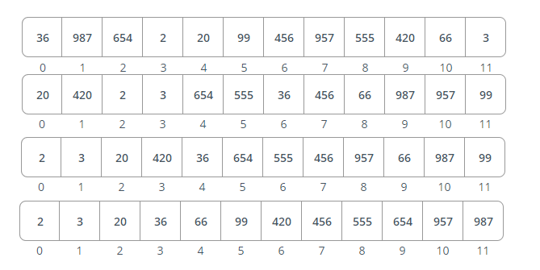
Radix Sort - Working

Slide 31
Radix Sort
Advantages
Radix Sort is a stable sort because it maintains the relative order of elements with equal values.
Fast when the keys are short, i.e. when the array element range is small.
Disadvantages
Because it is based on digits or letters, the radix sort is less flexible than other sorts. If the data type must be rewritten, so must the Radix sort.
The Radix Sort algorithm is less flexible than other sorts because it is based on digits or letters. As a result, for each different type of data, it must be rewritten.
Radix sort has a higher constant than other sorting algorithms.
It takes up more space than Quicksort, which is used for in-place sorting.

Slide 32
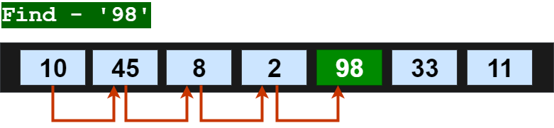
Linear Search
linear search algorithm or sequential search is a method for finding an element within a list. It sequentially checks each element of the list until a match is found or the whole list has been searched.

Slide 33
Linear Search Algorithm
Take the input array arr[] from user.
Take element(x) you want to search in this array from user.
Set flag variable as -1
LOOP : arr[start] -> arr[end]
if match found i.e arr[current_postion] == x then
Print “Match Found at position” current_position.
flag = 0
abort
After loop check flag variable.
if flag == -1
print “No Match Found”
STOP

Slide 34
Binary Search
Binary search algorithm falls under the category of interval search algorithms. This algorithm is much more efficient compared to linear search algorithm. Binary search only works on sorted data structures. This algorithm repeatedly target the center of the sorted data structure & divide the search space into half till the match is found.
The time complexity of binary search algorithm is O(Log n).

Slide 35
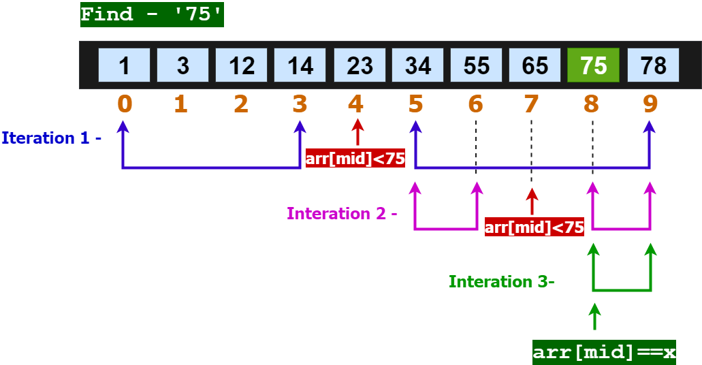
Binary Search – Continue

Slide 36
Binary Search Algorithm
Take input array, left, right & x
START LOOP – while(left greater than or equal to right)
mid = left + (right-left)/2
if(arr[mid]==x) then
return m
else if(arr[mid] less than x) then
left = m + 1
else
right= mid – 1
END LOOP
return -1

Slide 37
Advantages and Disadvantages
LINEAR SEARCH | BINARY SEARCH
O(N) | O(logN)
Prerequisite for an array No required | Array must be in sorted order
Can be implemented on Array and Linked list. | Cannot be directly implemented on linked list.
Elements Easily inserted at the end of list | Require processing to insert at its proper place to maintain a sorted list.
Algorithm type is Iterative in nature | Divide and conquer in nature
Easy to use and no need for any ordered elements. | Anyhow tricky algorithm and elements should be organized in order.
Less lines of code | More lines of code
It can be implemented on both a single and multidimensional array. | It can be implemented only on a single dimensional array.
It is less efficient in the case of large-size data sets. | It is more efficient in the case of large-size data sets.
The linear search can be implemented on any linear data structure such as an array, linked list, etc. | The implementation of binary search is limited as it can be implemented only on those data structures that have two-way traversal.

Slide 38
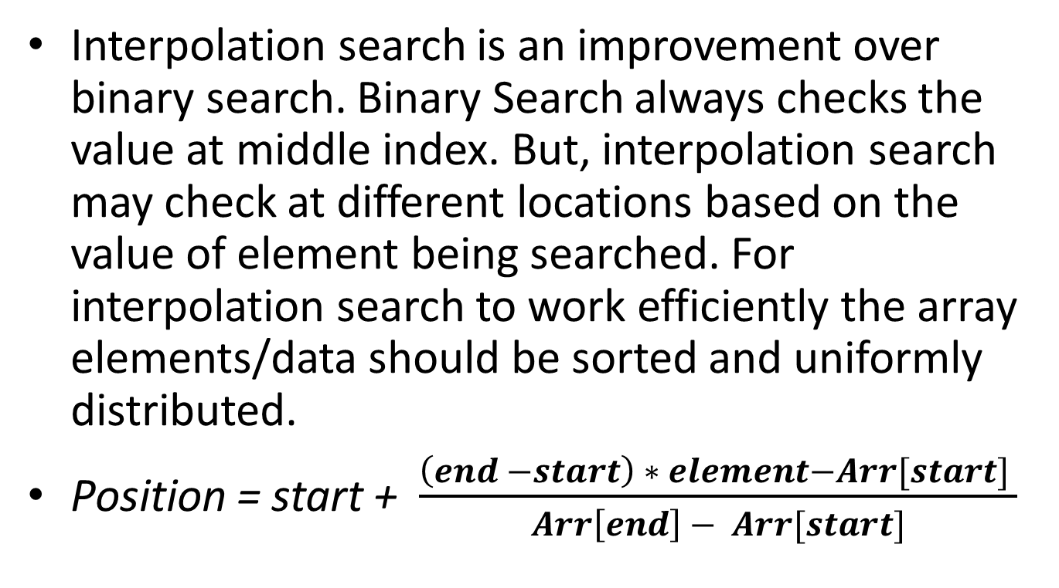
Interpolation Search
Interpolation search is an improvement over binary search. Binary Search always checks the value at middle index. But, interpolation search may check at different locations based on the value of element being searched. For interpolation search to work efficiently the array elements/data should be sorted and uniformly distributed.
Position = start + $\frac{\left(end −start\right) ∗ element−Arr[start] }{Arr\left[end\right] − Arr[start]}$

Slide 39
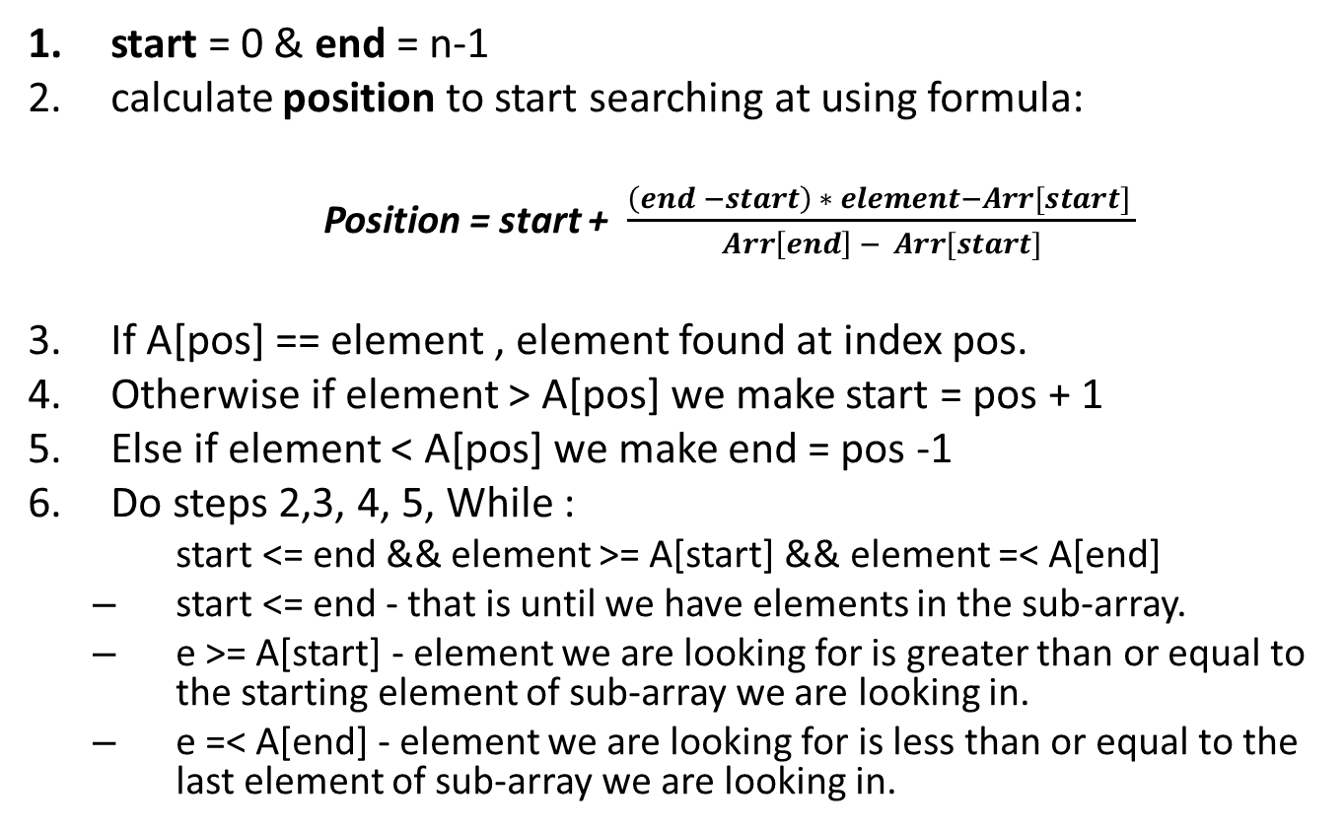
Interpolation Search Algorithm
start = 0 & end = n-1
calculate position to start searching at using formula:
Position = start + $\frac{\left(end −start\right) ∗ element−Arr[start] }{Arr\left[end\right] − Arr[start]}$
If A[pos] == element , element found at index pos.
Otherwise if element > A[pos] we make start = pos + 1
Else if element < A[pos] we make end = pos -1
Do steps 2,3, 4, 5, While :
start <= end && element >= A[start] && element =< A[end]
start <= end - that is until we have elements in the sub-array.
e >= A[start] - element we are looking for is greater than or equal to the starting element of sub-array we are looking in.
e =< A[end] - element we are looking for is less than or equal to the last element of sub-array we are looking in.

Slide 40
Interpolation Search continue
Advantages
If the items are uniformly distributed, the average case time complexity is log₂(log₂(n)).
It is considered an improvement in binary search.
Interpolation search works better than Binary Search for a sorted and uniformly distributed array.
Disadvantages
The calculation of mid is complicated. It increases the execution time.
If the items are not uniformly distributed, the interpolation search will have very poor behavior.

